Slide 1
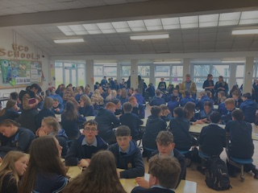
2021 - 2023
CREATIVE SCHOOLS, YEAR 1 CASE STUDY
ST JOSEPHS POST-PRIMARY
ROCHFORTBRIDGE, CO. WESTMEATH
School Coordinator: Yvonne Muldoon
Creative Associate: Aideen McHugh

Slide 2
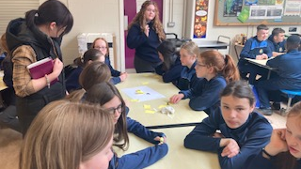
VISION:
To have whole school involvement,
affording every student the opportunity to tap into their creative skills
1030 STUDENTS
75 TEACHERS
1 SCHOOL COORDINATOR = MUSIC & SPHE TEACHER

Slide 3
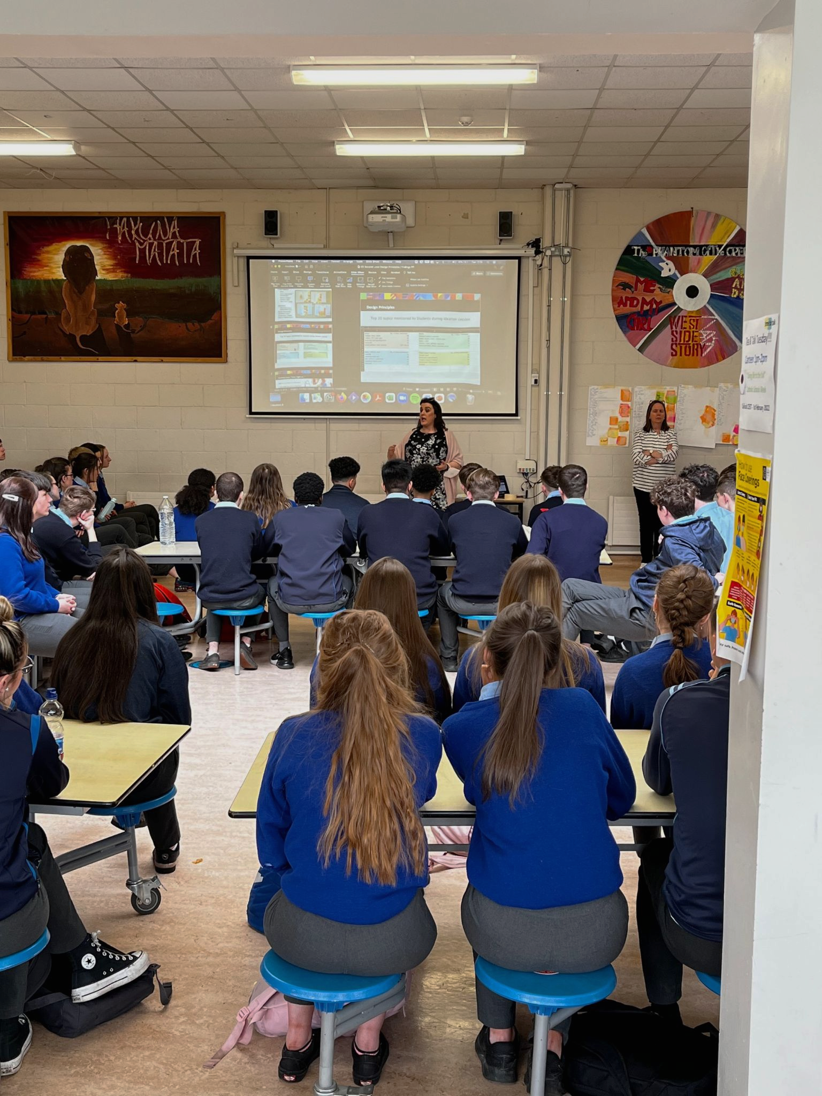
INVESTING TIME IN THE UNDERSTANDING PROCESS
Mobilize school community - staff, students and externals
Understanding Creativity - what it means to everyone
Lundy model of Participation – Discuss
Feedback – Staff and students, ongoing
“Sometimes it was hard to hear our teacher and Aideen because everyone was so enthusiastic and loud.” - Student
Relationship building - Creative Associate & school community
Student Voice
“It was a long process and some students were not that interested.” - Student
Notes:
Value in spending time. Contradicting student quotes highlight how various views need to be heard. The more time we gave, the more approaches we offered, the more we allowed and made possible spaces for young people engagement.

Slide 4
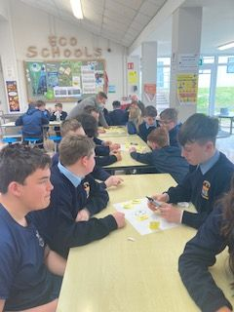
SCHOOL EXPECTATION INCLUDING CHALLENGES

Slide 5
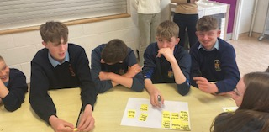
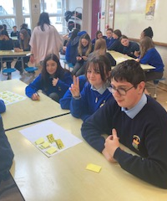
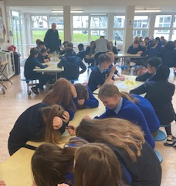
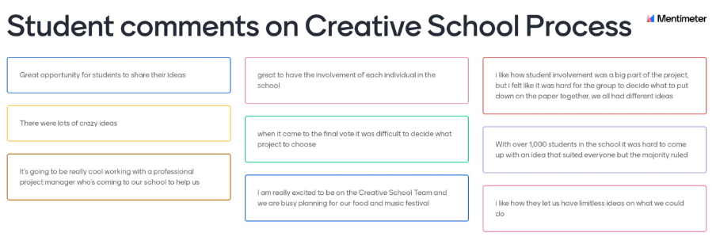
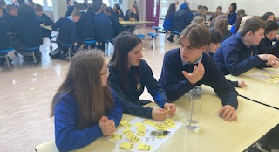
GETTING STARTED – IDEA GENERATION

Slide 6
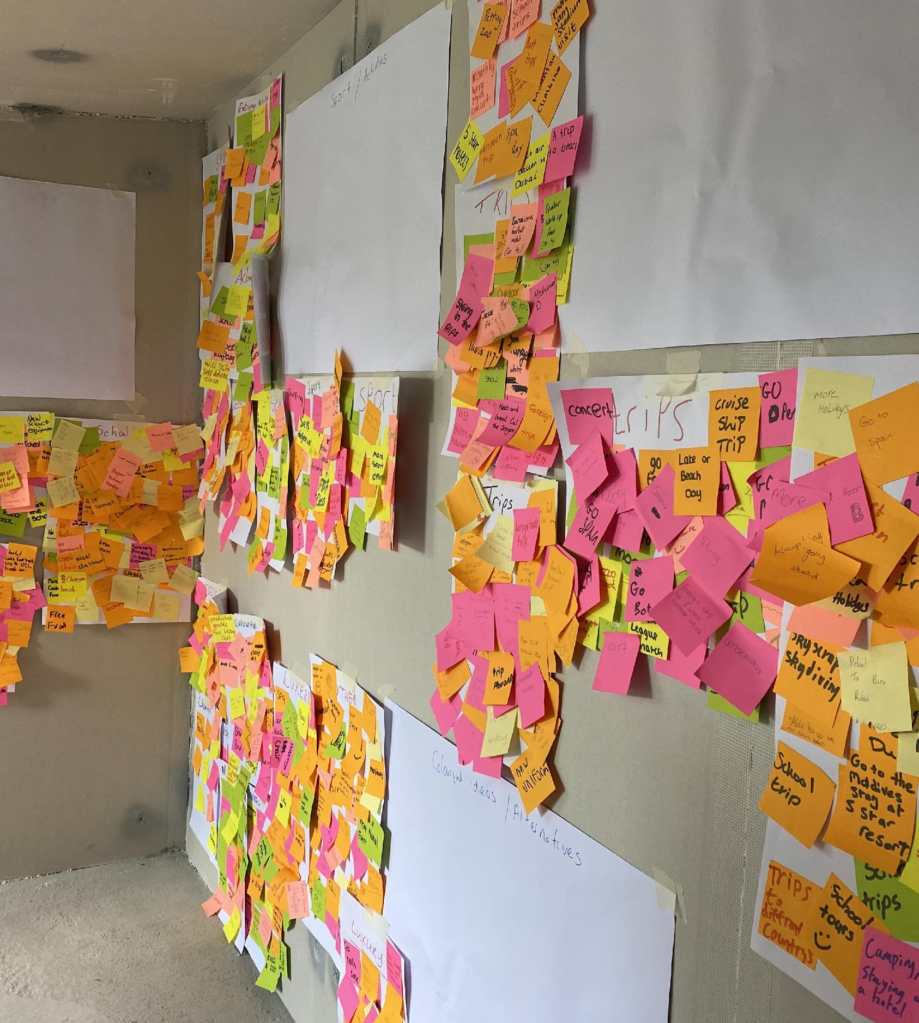
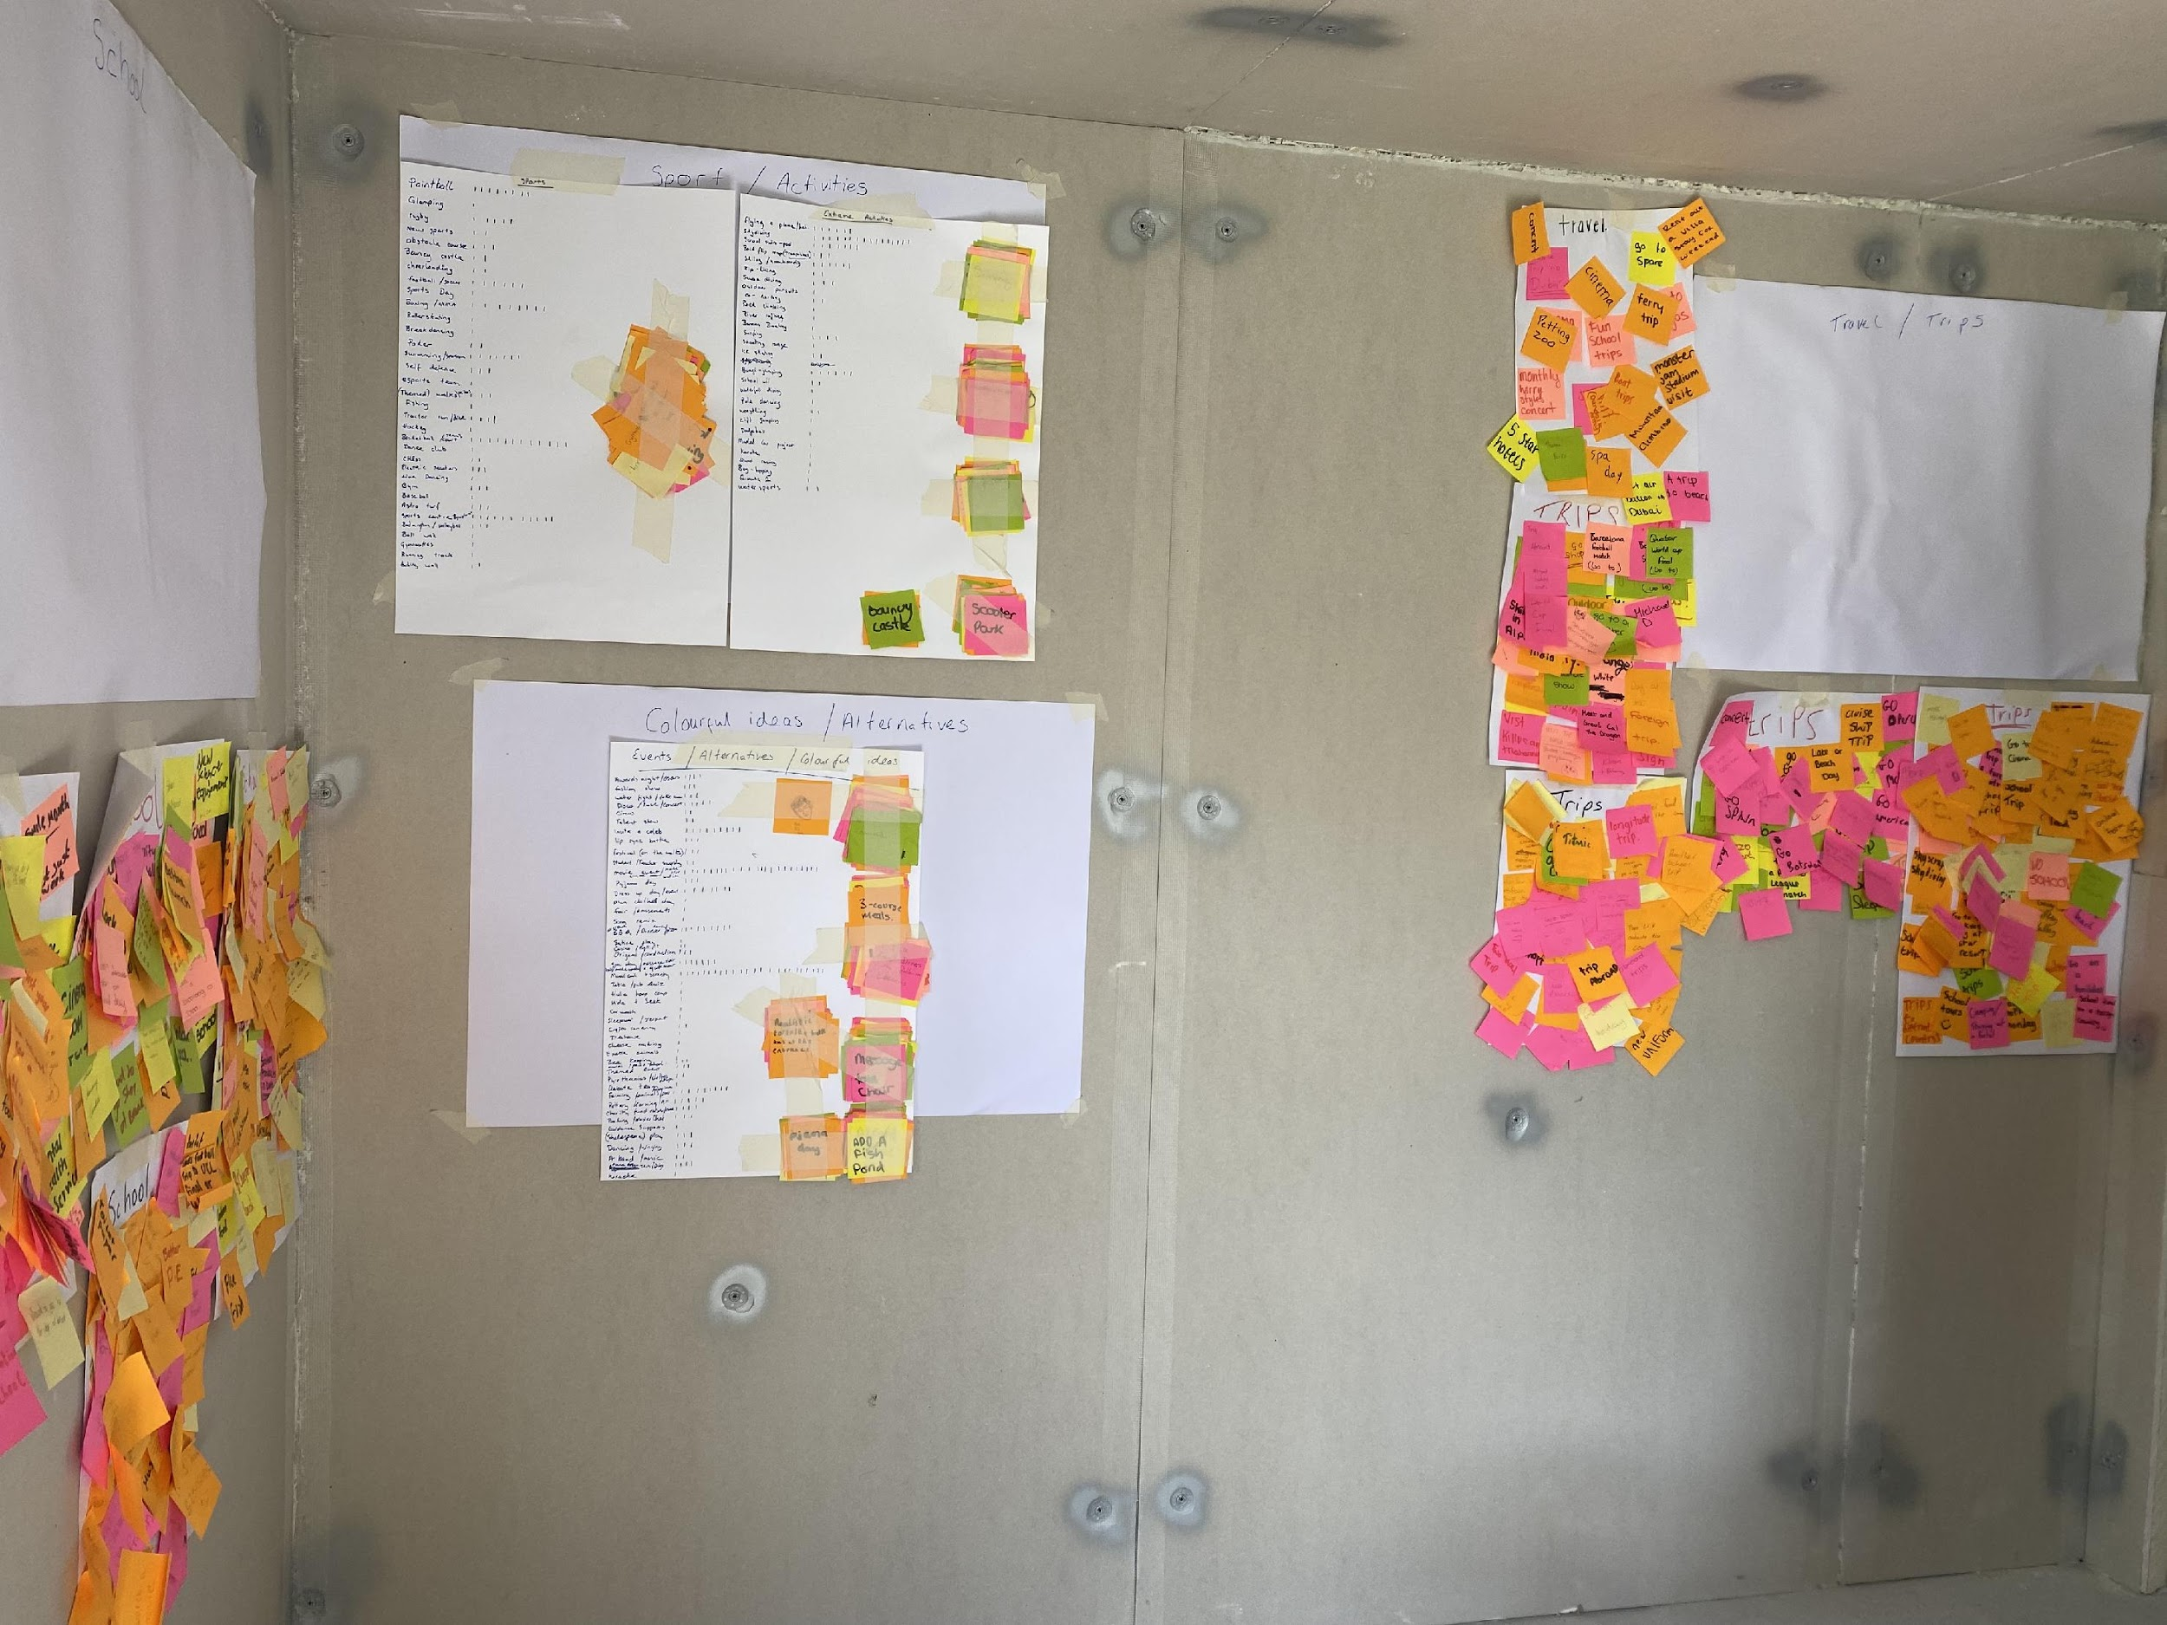
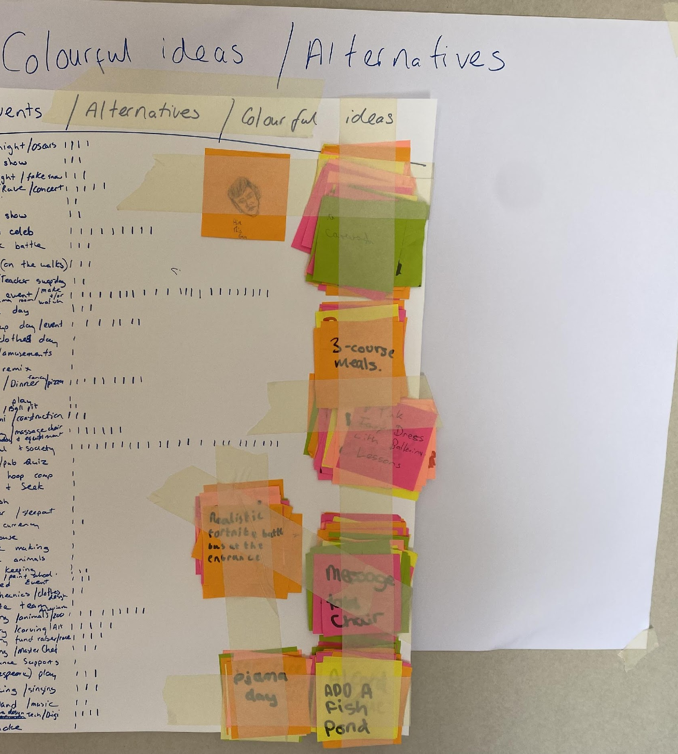
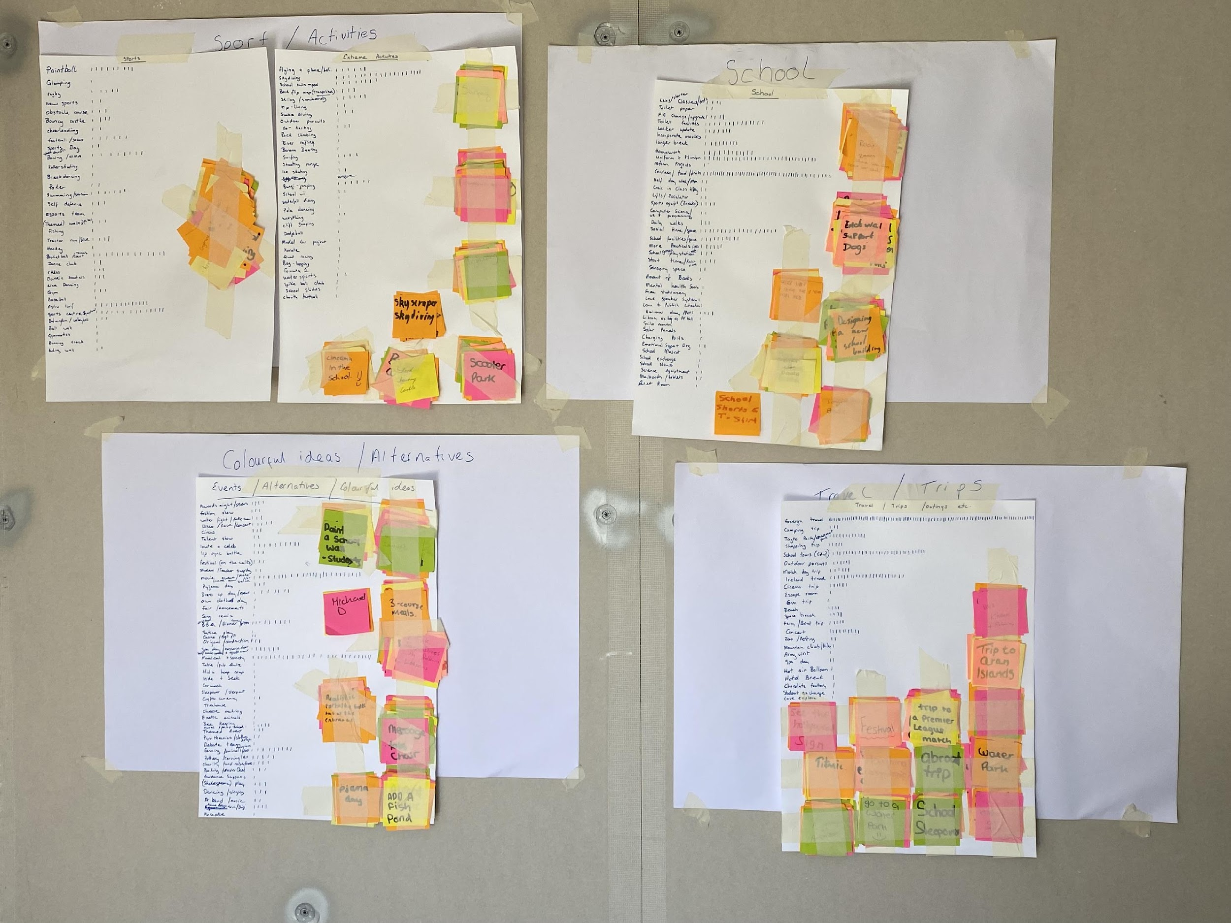
IDEA GROUPING & COUNTING
CAPTURING YOUNG PEOPLE'S VOICES

Slide 7
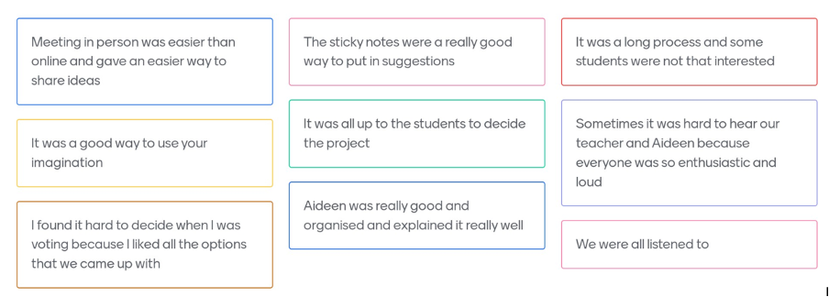
YOUNG PEOPLE FEEDBACK ON PROCESS

Slide 8
’UNDERSTANDING’ – THE JOURNEY
Introduce Creative Schools
Explore prior knowledge of creativity
Identify New areas of interest
Design thinking workshops
Students elect Creative school’s student council
Establish a teacher team
Students vote for year 2 project
Creative Schools Plan

Slide 9
KEY POINTS - UNDERSTANDING
Engage young people
Online interactions didn’t work well – reassessed & adapted
Design thinking workshops (in person) – large groups in canteen (ideation, finding patterns, design principles, make tangible – project planning)
Vote for preference - when main areas of interest were identified
Students vote for preferred project: Event / festival of music & food
Cinema room was close second, which school have identified as something to consider in new build, and with new film studio being created in Westmeath.

Slide 10
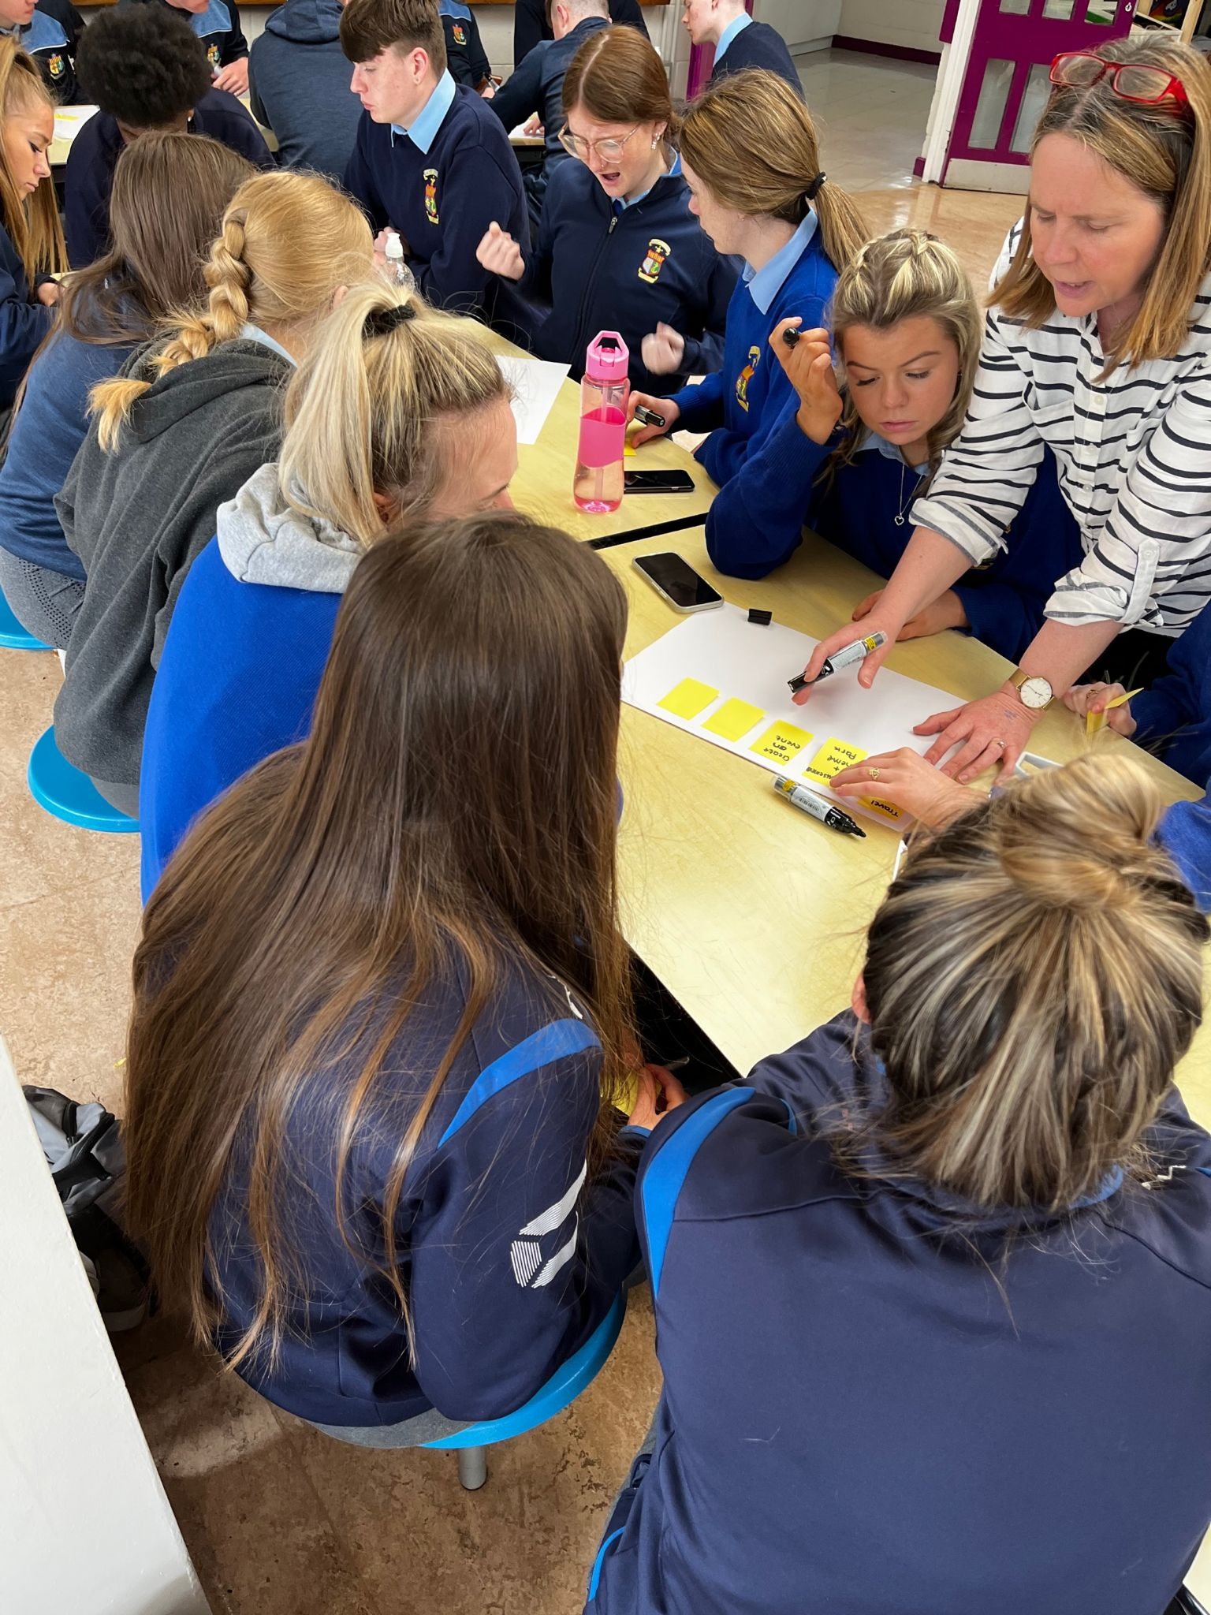
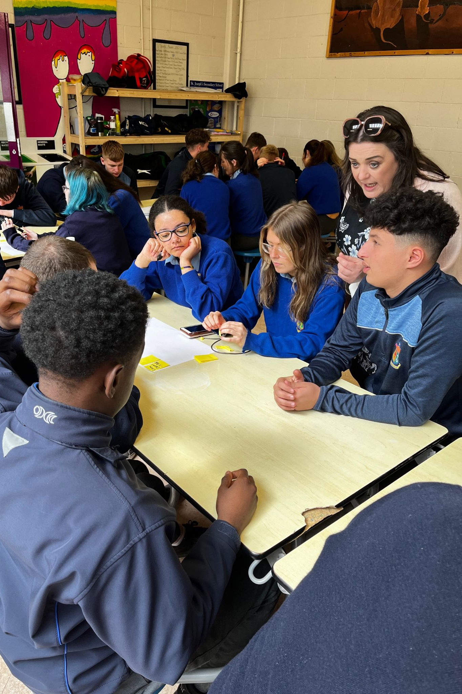
THANK YOU
Yvonne Muldoon
&
Aideen McHugh

